Slide 1
COOPERATIVE LEARNING & INTER-PERSONAL INTELLIGENCE IN THE CLASSROOMS
Assoc. Prof. Dr. Onur KÖKSAL

Slide 2
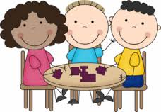
Cooperative Learning
Cooperative learning (CL) refers to students working in teams on an assignment or project under conditions in which certain criteria are satisfied, including that the team members be held individually accountable for the complete content of the assignment or project.

Slide 3
Cooperative Learning
According to the Johnson & Johnson model, cooperative learning is instruction that involves students working in teams to accomplish a common goal, under conditions that include the following elements;
1. Positive interdependence
2. Individual accountability
3. Face-to-face promotive interaction
4. Appropriate use of collaborative skills
5. Group processing

Slide 4
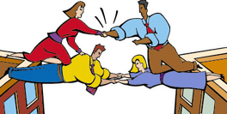
Cooperative Learning
1. Positive interdependence
Team members are obliged to rely on one another to achieve the goal. If any team members fail to do their part, everyone suffers consequences.

Slide 5
Cooperative Learning
1. Positive interdependence
Students must feel they need each other in order to complete the group’s task;
mutual goals
joint rewards
shared materials and information
assigned roles

Slide 6
Cooperative Learning
2. Individual accountability
All students in a group are held accountable for doing their share of the work and for mastery of all of the material to be learned.

Slide 7
Cooperative Learning
2. Individual accountability
Teams succeed when;
Every member has learned the material
Every member has helped complete tasks
Frequently teachers assess individual learning

Slide 8
Cooperative Learning
3. Face-to-face promotive interaction
Although some of the group work may be parcelled out and done individually, some must be done interactively, with group members providing one another with feedback, challenging reasoning and conclusions, and perhaps most importantly, teaching and encouraging one another.

Slide 9
Cooperative Learning
3. Face-to-face promotive interaction
Discussing
Summarizing
Explaining
Elaborating
Receiving feedback

Slide 10
Cooperative Learning
4. Appropriate use of collaborative skills
Students are encouraged and helped to develop and practice trust-building, leadership, decision-making, communication, and conflict management skills.

Slide 11
Cooperative Learning
4. Appropriate use of collaborative skills
Communication
Leadership
Decision-making
Conflict management
Active listening
Compromising
Challenging ideas not people

Slide 12
Cooperative Learning
5. Group processing
Team members set group goals, periodically assess what they are doing well as a team, and identify changes they will make to function more effectively in the future.

Slide 13
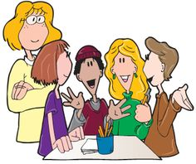
Cooperative Learning
5. Group processing
Give students time to analyze how well their teams are doing with;
Learning tasks
Social skill
Self-assessment

Slide 14
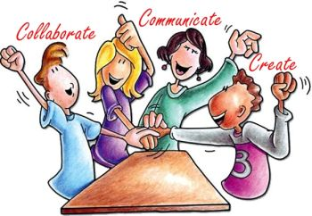
Cooperative Learning
Cooperative learning is not simply a synonym for students working in groups. A learning exercise only qualifies as cooperative learning to the extent that the five listed elements are present.

Slide 15
Cooperative Learning in the Classroom
Cooperative learning can be used in for any type of assignment that can be given to students in lecture, classes, laboratories, or project-based courses. Some of the structures that can be used are;
. Problem Sets . Peer Editing
. Jigsaw . Laboratories and Projects

Slide 16
Cooperative Learning in the Classroom
Problem Sets: Students complete some or most of their homework assignments in teams. The teams are encouraged to include only the names of actual participants on the solution set that they hand in. The students are initially disinclined to leave anyone’s name off, but eventually they get tired of letting nonparticipants (“hitchhikers,” in cooperative learning parlance) get good grades for work they didn’t do and begin to omit names, at which point many hitchhikers—unhappy about getting zeroes on assignments—start cooperating.

Slide 17
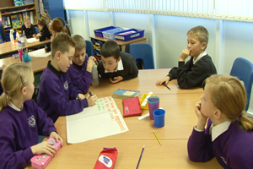
Cooperative Learning in the Classroom
Problem Sets: The team gets a grade for the assignment, but eventually the performance of each team member should be assessed and the results used to adjust the average team homework grade separately for each team member.

Slide 18
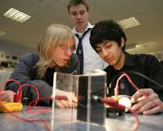
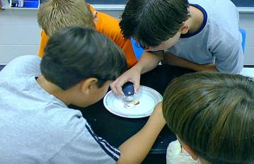
Cooperative Learning in the Classroom
Laboratories and Projects: Laboratories and projects may be carried out by teams (as they often are in traditional curricula), except that again the team grades should be adjusted for individual performance.

Slide 19
Cooperative Learning in the Classroom
Laboratories and Projects: The problem with team labs and projects as they are normally conducted is that there is no individual accountability at all. The result is the familiar situation in which some team members do the bulk of the work, others contribute little and understand little or nothing about the project, everyone gets the same grade, and resentment abounds. It is a good idea to include some individual testing on every aspect of the project and have the results count toward the final course grade. If this is done, hitchhikers who understand either nothing or only the little they did personally will be penalized and perhaps induced to play a more active role in subsequent work.

Slide 20
Cooperative Learning in the Classroom
Jigsaw: Jigsaw is a cooperative learning structure applicable to team assignments that call for expertise in several distinct areas.

Slide 21
Cooperative Learning in the Classroom
Jigsaw: For example, in a laboratory exercise, areas of expertise might include experimental design, equipment calibration and operation, data analysis (including statistical error analysis), and interpretation of results in light of theory, and in a design project the areas might be conceptual design, process instrumentation and control, safety and environmental impact evaluation, and cost and profitability analysis.

Slide 22
Cooperative Learning in the Classroom
Peer Editing: When teams turn in written lab reports and/or give oral presentations, a good alternative to instructor doing the critiquing and grading is peer editing, in which pairs of groups do the critiquing for each other’s first drafts (written) or run-throughs (oral).

Slide 23
Cooperative Learning in the Classroom
Peer Editing: If a grading checklist or rubric is to be used for grading the team reports (which is always a good idea), it should be shared with the students before the reports are written and used for the peer editing. This practice helps the students understand what the instructor is looking for and invariably results in the preparation of better reports, and it also helps assure that the peer critiques are as consistent and useful as possible.

Slide 24
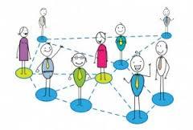
Interpersonal Intelligence
Interpersonal intelligence is the ability to establish and maintain human relationships, involving the capacity to perceive and respond to the moods, characteristics, intentions, temperaments, motivations and feelings of others, learning from them and contributing to their personal development.

Slide 25
Interpersonal Intelligence
The following social skills are those typically characteristic of individuals with Interpersonal Intelligence:-
Social Sensitivity - Socially astute, aware and concerned for others
Socially Influential - The ability to be able to persuade and influence others
Interpersonal Work - An interest for and skilled at work requiring a sensitivity towards people

Slide 26
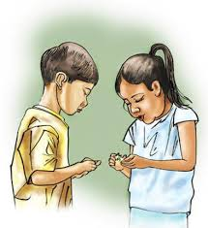
Interpersonal Intelligence
Interpersonal learners benefit from being able to see things from others point of view. I.e. to re-enact the movement of an animal or consider how an individual may have been feeling at the time and place of an historic event. People-Smart people, (Interpersonal intelligence) enjoy working, learning, helping and being around other people

Slide 27
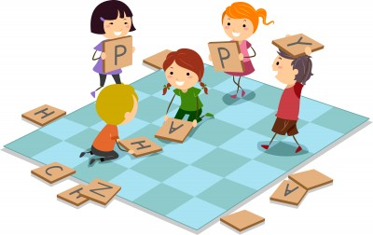
Interpersonal Intelligence
Strengths of learners with interpersonal intelligence:
They love being with people and relate to them very well
They like working in teams to accomplish tasks
They can lead very well
They also show concern and empathy for others
They can make very persuasive arguments

Slide 28
Interpersonal Intelligence
Activities that children with interpersonal intelligence enjoy
Working with other children, especially those younger to them
Meeting and getting information from various people
Collaborative activities
Love talking about themselves or what they do, with other people
Helping others - volunteering
Interacting with family
Monitoring "rules" and "practices" in the household

Slide 29
Interpersonal Intelligence in the Classroom
Some of the activities used with learners with interpersonal intelligence in the classroom are;
What Would You Do?
What Are They Feeling?
Interview Someone Interesting
Build a Fort
Body Language Charades

Slide 30
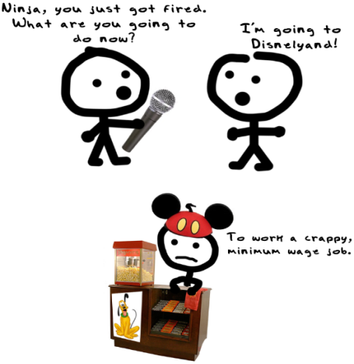
Interpersonal Intelligence in the Classroom
What Would You Do? Read or make up a story for your students that sets up a conflict between two friends and discuss. What would you do in that situation? Why? How might the characters handle things differently?

Slide 31
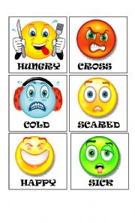
Interpersonal Intelligence in the Classroom
What Are They Feeling? Show your students pictures of people or characters. Ask the following questions and discuss: ‘What do you think this person is feeling?’, ‘What to you notice about how they’re standing/sitting?’ and ‘What is their body language saying?’ You can do this nonchalantly while reading a story, watching a show, or people-watching at the zoo to raise your child’s awareness of what others say without saying a word.

Slide 32
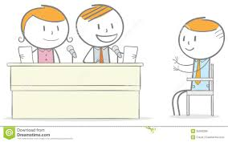
Interpersonal Intelligence in the Classroom
Interview Someone Interesting. What are your students interested in? Do they want to learn more about their grandfather’s time in the war? Is there a neighbor who knows a lot about animals? Once your they decide on a person of interest, help them write down questions he wants to ask ahead of time. The results of the interview can be turned into a creative project of some kind (like a biography book with pictures, or a poster).

Slide 33
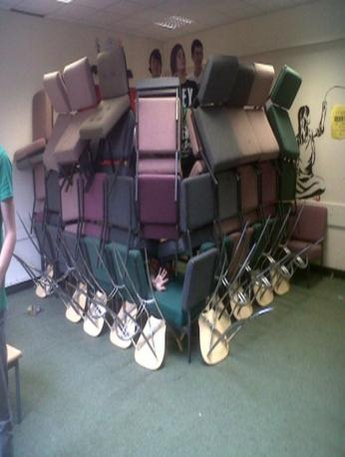
Interpersonal Intelligence in the Classroom
Build a Fort: Building forts should be a team effort between kids, and offer a fun opportunity to practice creativity and communication. You can supervise, give suggestions and make sure everyone is being safe, however the whole point is for your students to work together with friends toward a common goal. Two types of forts to try: an indoor pillow-and-blanket fort and an outdoor lean-to fort made of sticks, leaves and branches.

Slide 34
Interpersonal Intelligence in the Classroom
Body Language Charades: Brainstorm a number of different emotions with your students, and write each on a separate piece of paper. (This is also an opportunity to expand their vocabulary and explore emotional nuance). Emphasize the facial expressions and body language by not allowing any sounds. Pull one at a time out of a bag or hat, and act out the emotion!

Slide 35
Interpersonal Intelligence in the Classroom
Helping students with interpersonal intelligence learn
For students with interpersonal intelligence, direct interaction, discussions with others and team efforts are the best pathways to help them learn.
Get them together with other students to do projects
Assign activities that require them to meet and interact with people
Let them do "role play"
Let them explain to you what they have learnt or discovered - listen carefully
When explaining or teaching things, try to insert multiple characters and personalities into it
Assign them responsibility to lead a team and discover more information about certain areas or give them a project to make something complex

Slide 36
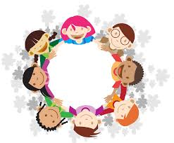
THANK YOU!
Assoc. Prof. Dr. Onur KÖKSAL

